Slide 1



Optimizing Impression Counts for Outdoor Advertising
Yipeng Zhang, Yuchen Li, Zhifeng Bao, Songsong Mo and Ping Zhang
RMIT University, Melbourne, Australia

Slide 2



$30 Billion
80%

Slide 3



Impression Counts for Outdoor Advertising
Trajectory
Billboards
Budget

Slide 4
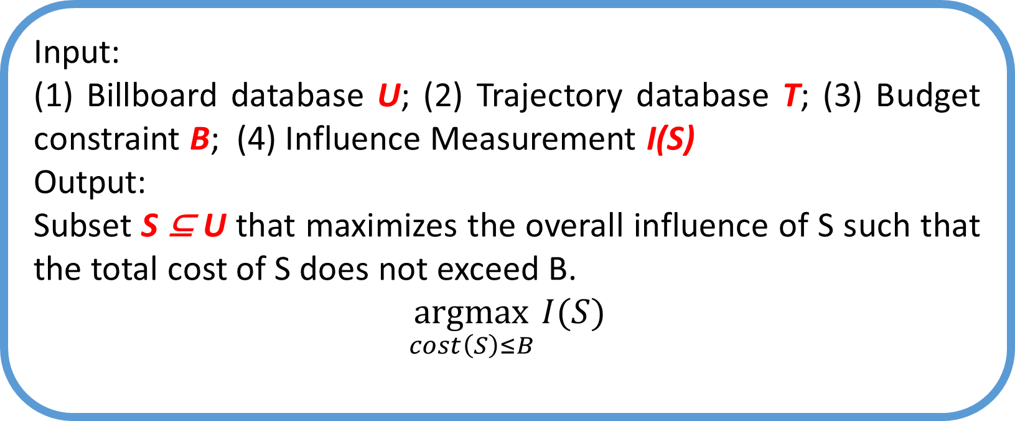
Impression Counts for Outdoor Advertising
Input:
(1) Billboard database U; (2) Trajectory database T; (3) Budget constraint B; (4) Influence Measurement I(S)
Output:
Subset S ⊆ U that maximizes the overall influence of S such that the total cost of S does not exceed B.
$$\underset{cost\left(S\right)≤B}{argmax}{I(S)}$$
Trajectory
Billboards
Budget

Slide 5

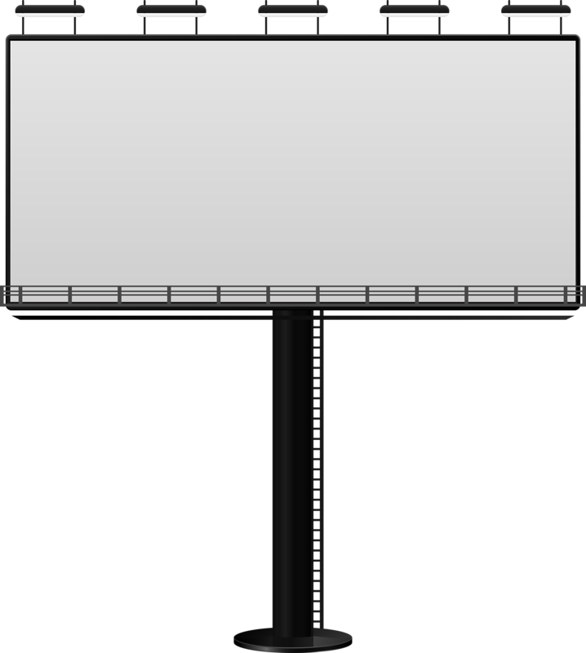


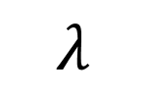
1. How a billboard impresses an audience?
$$λ$$

Slide 6
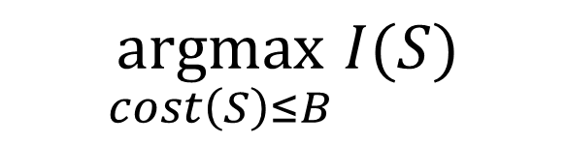
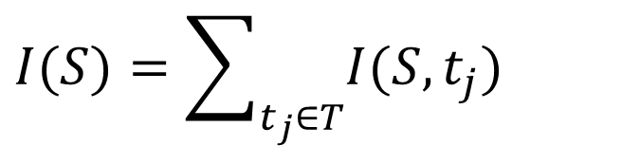
Is It enough for impressing a person only one time?
2. Influence Measurement
$$\underset{cost\left(S\right)≤B}{argmax}{I(S)}$$
$$I(S)=\sum_{t_{j}∈T}{I(S,t_{j})}$$
(Ping et al., SIGKDD 2018 [1])
One-time impression is not enough (Gershon et al., 1985[2]; William et al., 2003 [3])

Slide 7
2. Influence Measurement
Influence
1st Time
Impression Times
I see it!

Slide 8
2. Influence Measurement
Influence
2nd Time
1st Time
Impression Times
It is familiar!

Slide 9
2. Influence Measurement
3rd Time
Influence
2nd Time
1st Time
Impression Times
I remember it!

Slide 10
Influence
Impression Times

Slide 11
The logistic function (Advertising market and Customer behavior [4-7])
The effectiveness of advertisement repetition varies from one person to another.
Influence
Impression Times

Slide 12
The logistic function (Advertising market and Customer behavior [4-7])
The effectiveness of advertisement repetition varies from one person to another.
Influence
Impression Times

Slide 13
The logistic function (Advertising market and Customer behavior [4-7])
The effectiveness of advertisement repetition varies from one person to another.
Influence
Impression Times

Slide 14
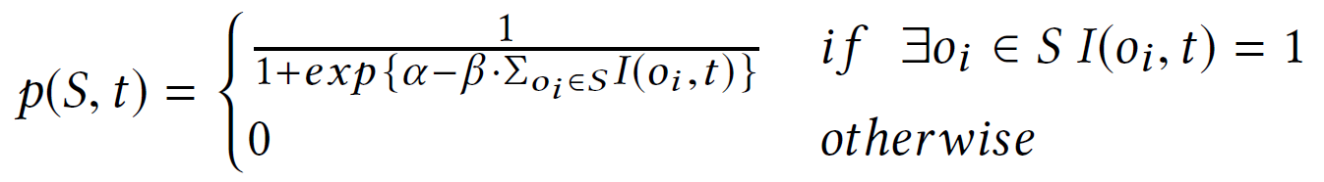
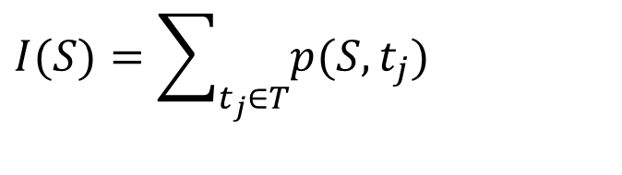
Influence Measurement
Influence
$$I(S)=\sum_{t_{j}∈T}{p(S,t_{j})}$$
Impression Times

Slide 15
1. Influence Measurement is not submodular
- No approximation ratio for a greedy-based algorithm
Upper-bound Estimation (submodular)
2. NP-hard to approximate within any constant factor
Branch-and-Bound Framework
Challenges
Solution

Slide 16
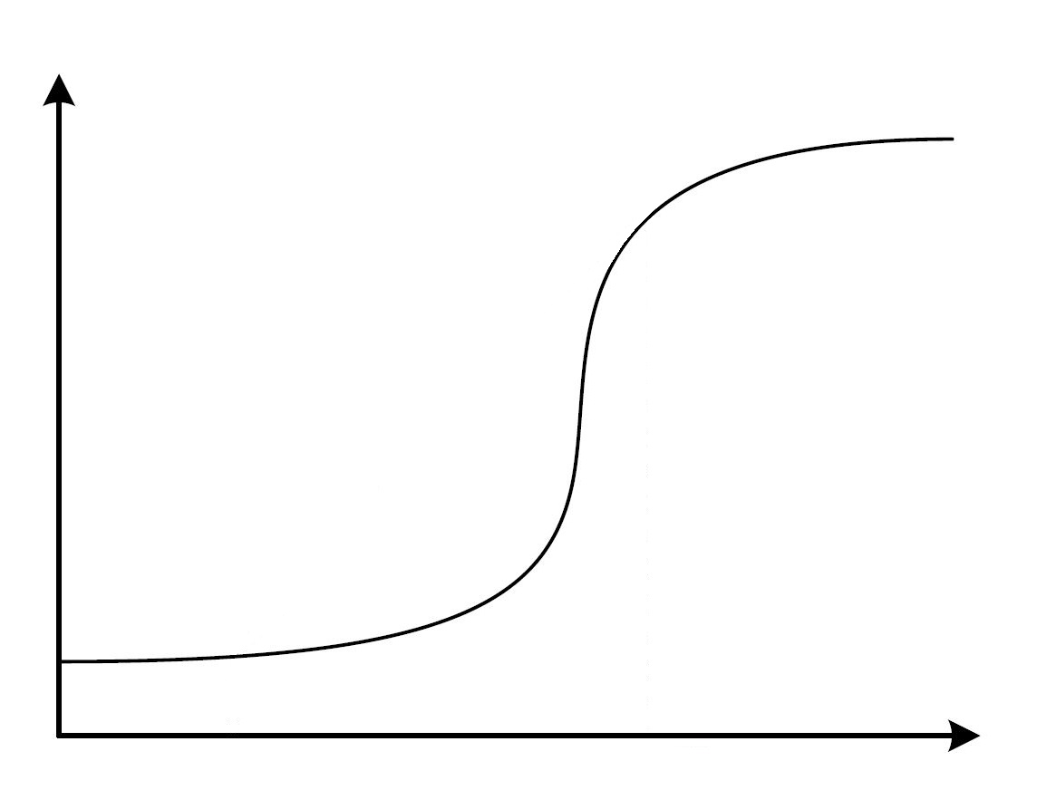
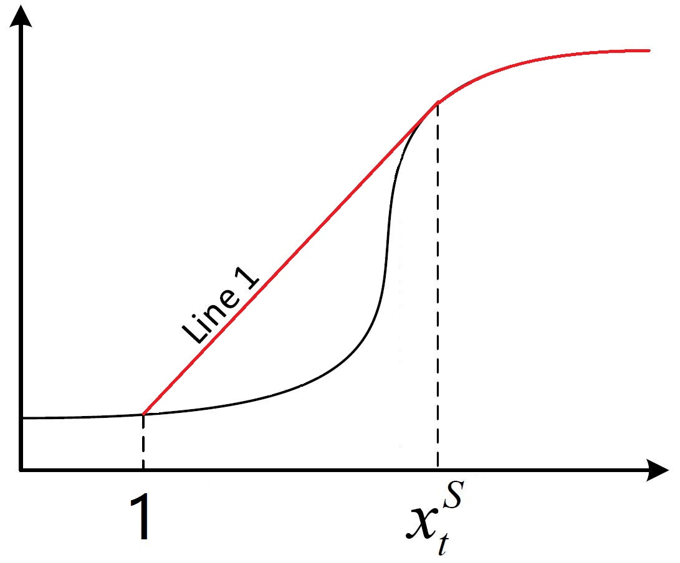
Upper-bound Estimation
Tangent Point
Upper
Bound
Influence
Lower
Bound
Impression Times

Slide 17
Upper-bound Estimation
Upper
Bound
Upper
Bound
Influence
Influence
Lower
Bound
Lower
Bound
Strategy 1
Impression Times

Slide 18
Upper-bound Estimation
Influence
Influence
Strategy 1
Impression Times

Slide 19
Upper-bound Estimation
Influence
Influence
Strategy 2
Strategy 1
Impression Times

Slide 20
Upper-bound Estimation
Influence
Influence
Strategy 1
Strategy 2
Impression Times

Slide 21
Upper-bound Estimation
Strategy 1

Slide 22
Branch-and-Bound Framework
Branch

Slide 23
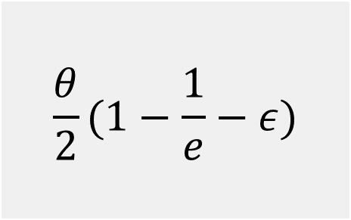
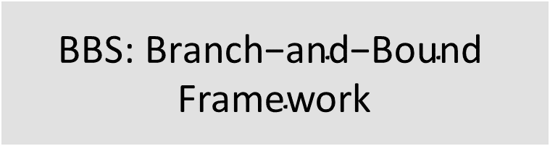

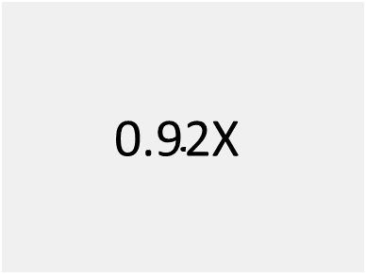
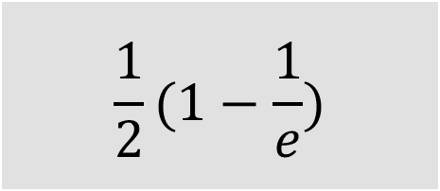
Optimization
 | Approximation Ratio | Effectiveness | Efficiency
$$\text{BBS}\text{: }\text{Branch}\text{−}\text{and}\text{−}\text{Bound} \text{Framework}$$
$$\frac{1}{2}(1−\frac{1}{e})$$
1X
1X
PBBS: Branch-and-Bound Framework with Progressive Bound-Estimation
$$\frac{θ}{2}(1−\frac{1}{e}−ε)$$
$$\text{0.92}\text{X}$$
$$\text{5}\text{0}\text{X}$$

Slide 24
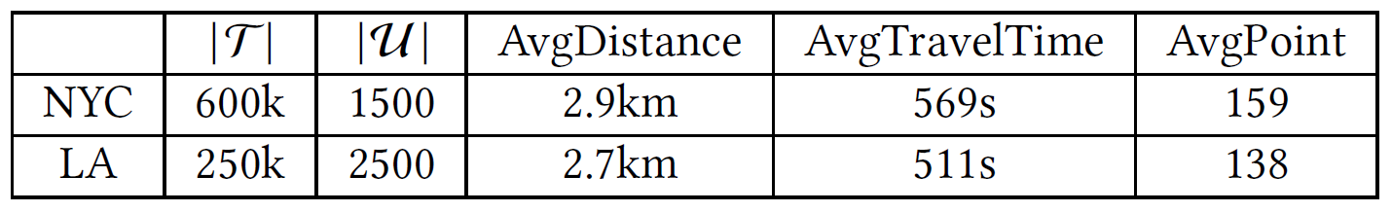
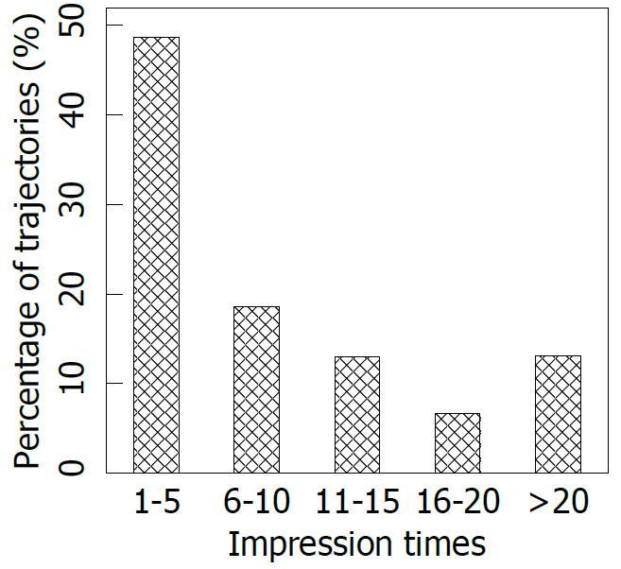
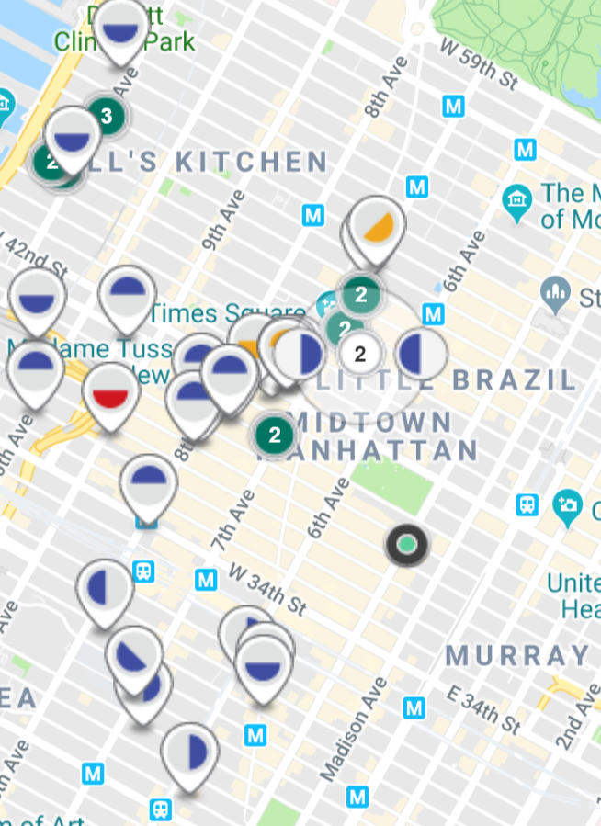
Experiment - Statistics of datasets
1
2
¹ TLC; ² Lamar

Slide 25
Experiment - Algorithms
Greedy: Maximum ratio of marginal influence gain to cost
Top-k: Maximum number of trajectories
BBS: Branch-and-bound framework
PBBS: Branch-and-bound framework with progressive Bound Estimation
LazyProbe: The best-performing method in [1]
Ping et al., SIGKDD 2018 [1]

Slide 26
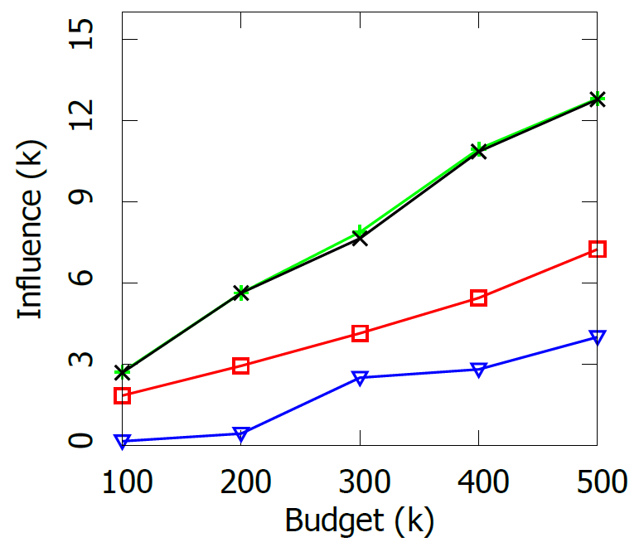
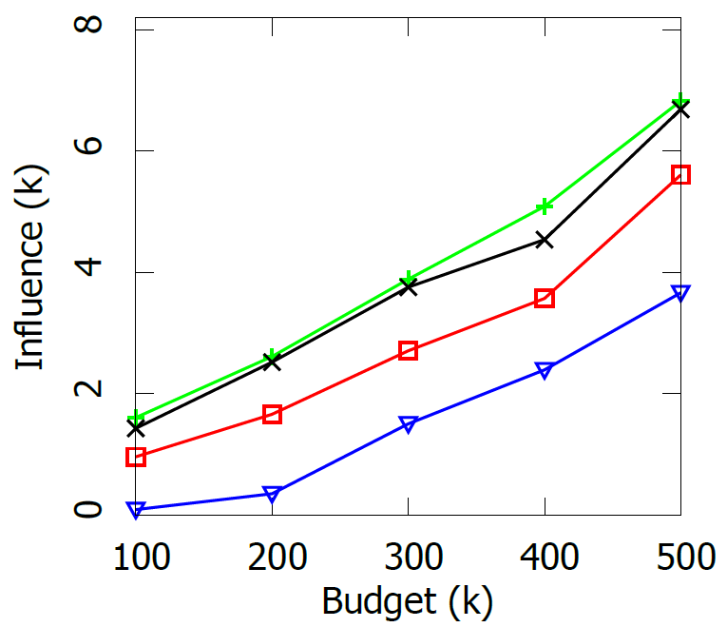

Varying the budget $B$
Figure 1: Influence in NYC
Figure 2: Influence in LA

Slide 27
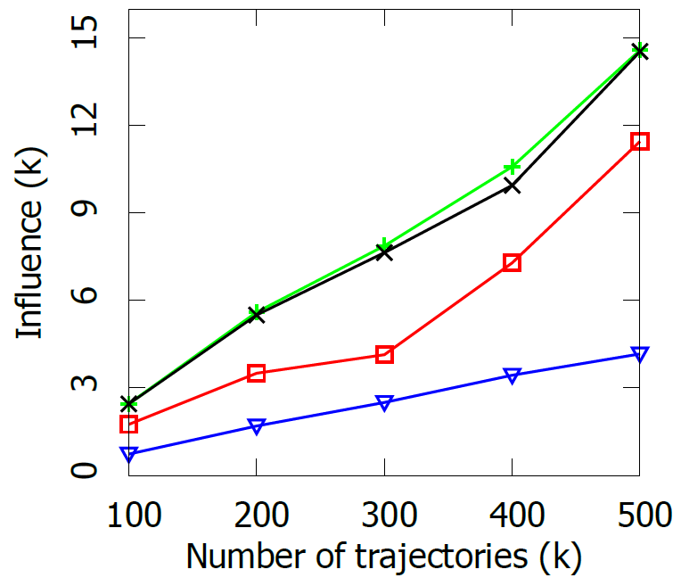
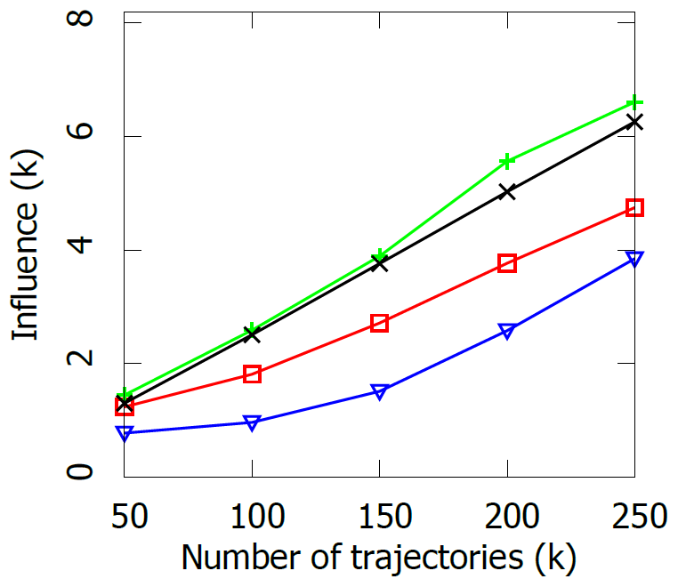

Varying the number of trajectories $|T|$
Figure 3: Influence in NYC
Figure 4: Influence in LA

Slide 28
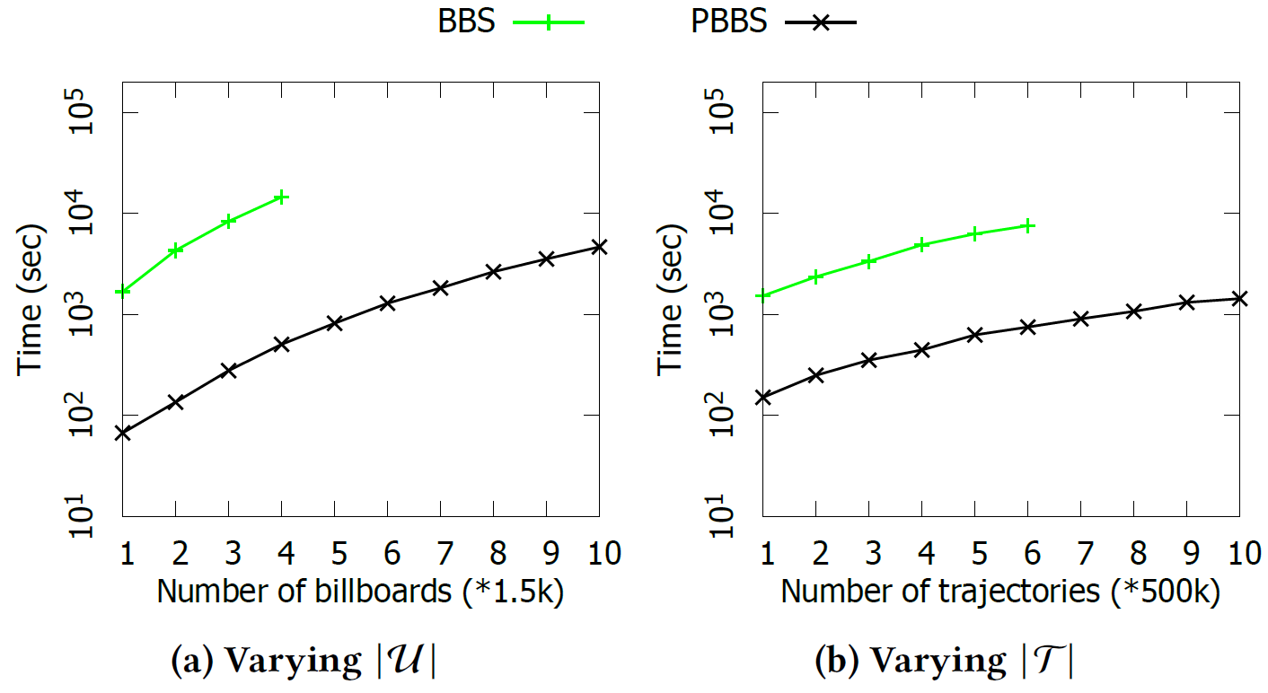
Scalability test in NYC

Slide 29
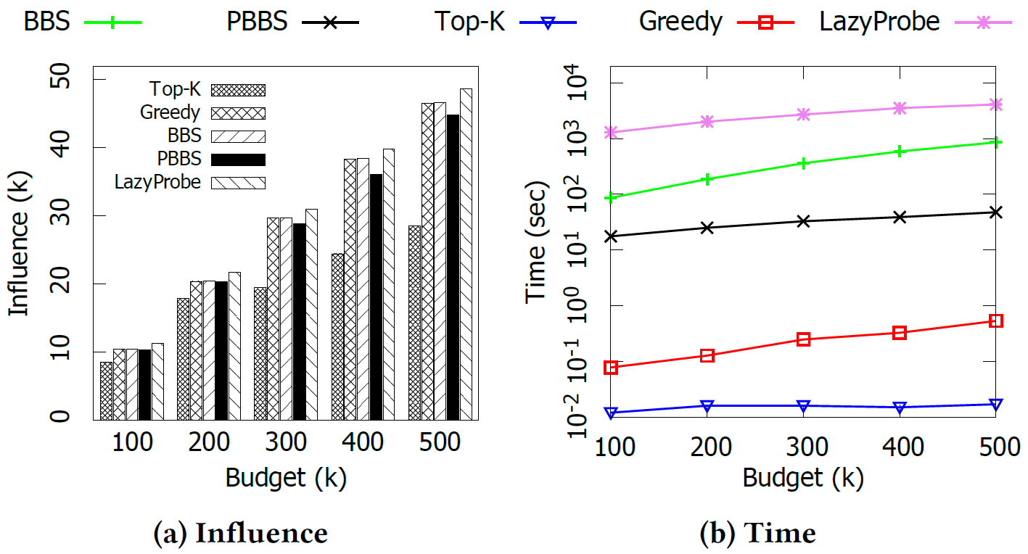
Comparison with LazyProbe

Slide 30
Conclusion
Real Problem
Meet more than one billboard in each travel (Impression Count)
Non-uniform cost of billboards
Budget
Real Solution
While having the approximation guarantee
Real-world Trajectory Dataset and Billboard Dataset
Takeaways
Personal driving trajectories
Personal identification of trajectories
Digital Billboards

Slide 31
References
[1] Ping Zhang, Zhifeng Bao, Yuchen Li, Guoliang Li, Yipeng Zhang, and Zhiyong Peng. 2018. Trajectory-driven Influential Billboard Placement. In SIGKDD. ACM, 2748–2757.
[2] Feder, Richard E Just, and David Zilberman. 1985. Adoption of agricultural innovations in developing countries: A survey. Economic development and cultural change 33, 2 (1985), 255–298.
[3] William H Greene. 2003. Econometric analysis. Pearson Education India.
[4] Margaret C Campbell and Kevin Lane Keller. 2003. Brand familiarity and advertising repetition effects. Journal of consumer research 30, 2 (2003), 292–304.
[5] Johny K Johansson. 1979. Advertising and the S-curve: A new approach. Journal of Marketing Research (1979), 346–354.
[6] John DC Little. 1979. Aggregate advertising models: The state of the art. Operations research 27, 4 (1979), 629–667.
[7] Julian L Simon and Johan Arndt. 1980. The shape of the advertising response function. Journal of Advertising Research (1980).
[8] LAMAR. 2017. National Rate Card. http://apps.lamar.com/demographicrates/content/salesdocuments/nationalratecard.xlsx

Slide 32
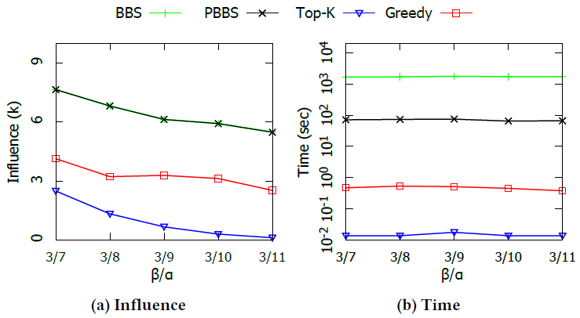

Varying $β/α$in NYC

Slide 33
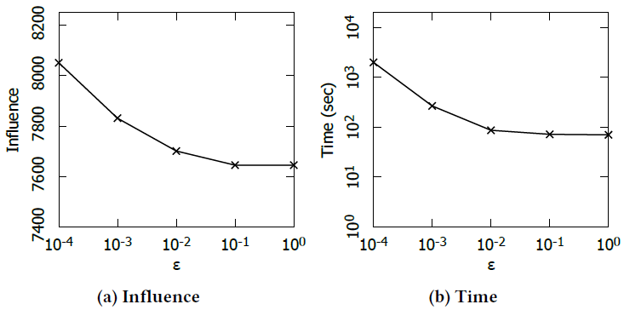

Varying $ε$ in NYC

Slide 34
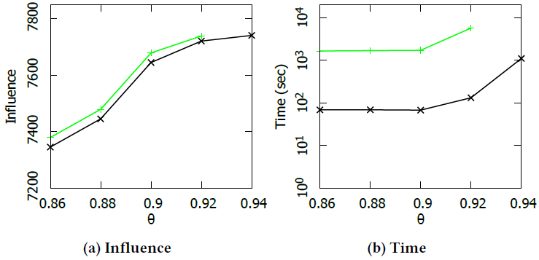

Varying $θ$ in NYC

Slide 35
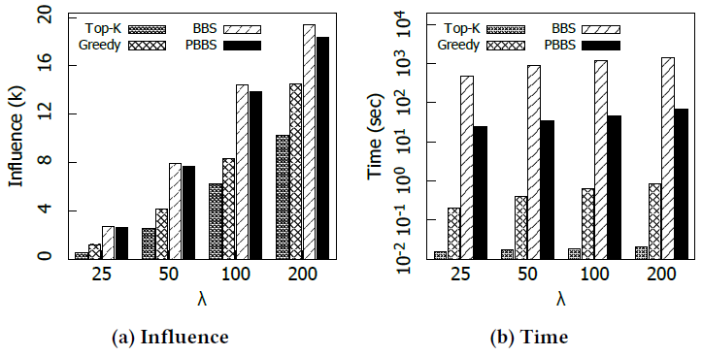

Varying $λ$ in NYC

Slide 36
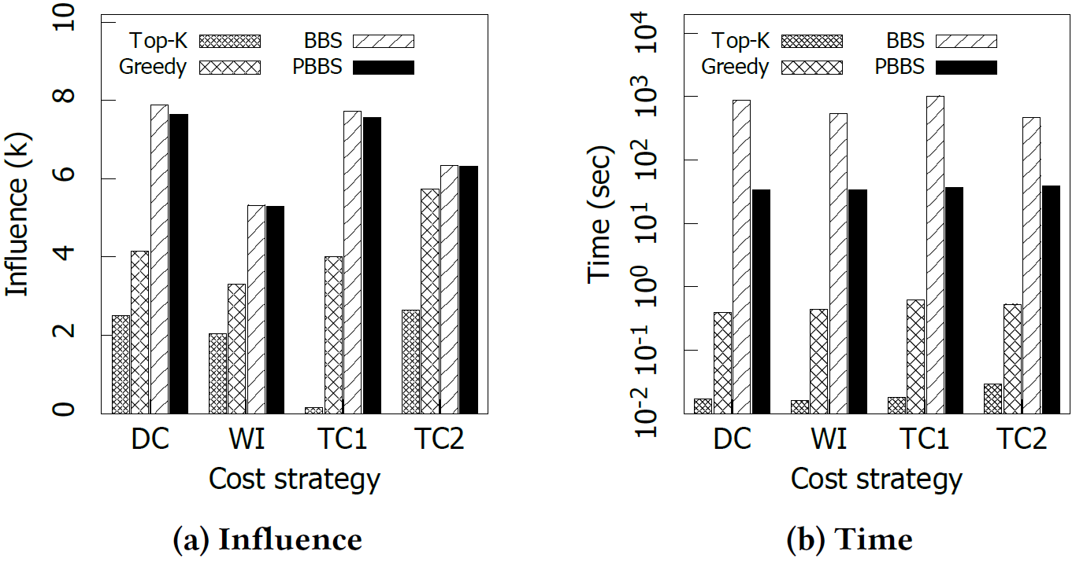
Test on different cost setting strategies

Slide 37
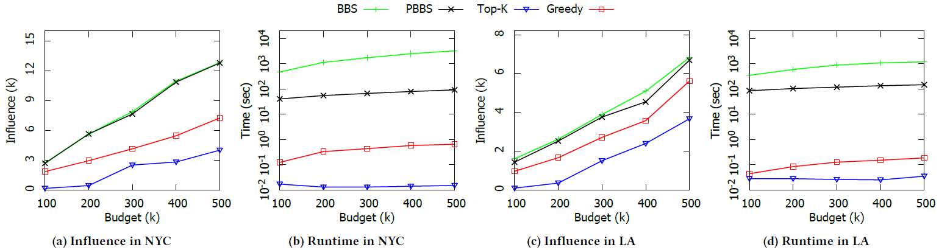
Varying the budget $B$

Slide 38
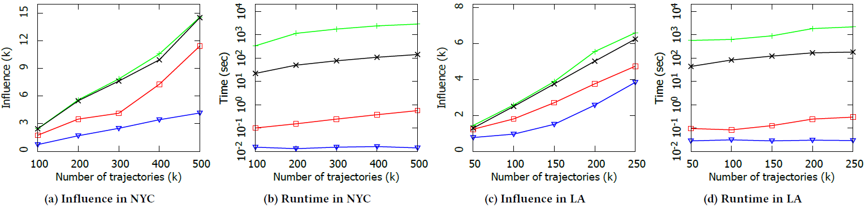

Varying the number of trajectories |$T$|

Slide 39



